Slide 1
Terraform for Azure

Slide 3
Terraform to Azure Module 03 - Terraform Basic

Slide 4
Overview
After completing this learning unit, you will understand
Azure Provider
First Terraform Project
Basic Commands
Store Terraform state in Azure

Slide 5
Azure Provider
Notes:
Browse Providers | Terraform Registry

Slide 6
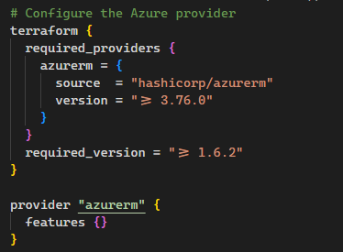
Azure Provider
The Azure Provider can be used to configure infrastructure in Microsoft Azure using the Azure Resource Manager API's.

Slide 7
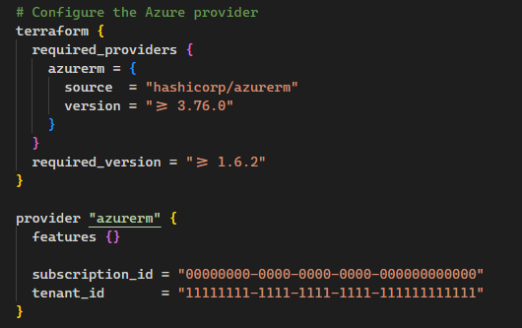
Azure Provider - Configurations
It's also possible to configure Terraform to use a specific configurations like Subscription, Tenant, etc

Slide 8
Authenticating
Azure CLI
Managed Service Identity
Service Principal and a Client Certificate
Service Principal and a Client Secret
OpenID Connect
Notes:
Docs overview | hashicorp/azurerm | Terraform | Terraform Registry

Slide 9
Provider List
API Management (azurerm_api_management)
App Service - Web Apps (azurerm_app_service)
Key Vault (azurerm_key_vault)
Storage (azurerm_storage_account)
SQL Database (azurerm_mssql_server, azurerm_mssql_database)
Kubernetes (azurerm_kubernetes_cluster)
Registry (azurerm_container_registry)
Etc..
Notes:
Docs overview | hashicorp/azurerm | Terraform | Terraform Registry

Slide 10
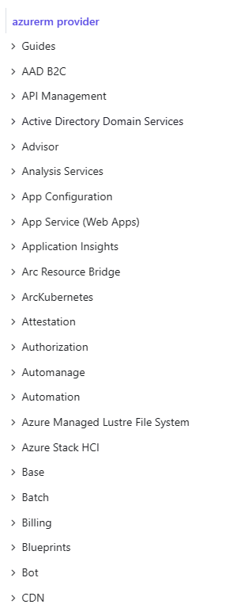
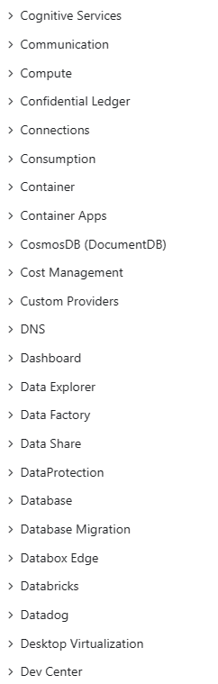
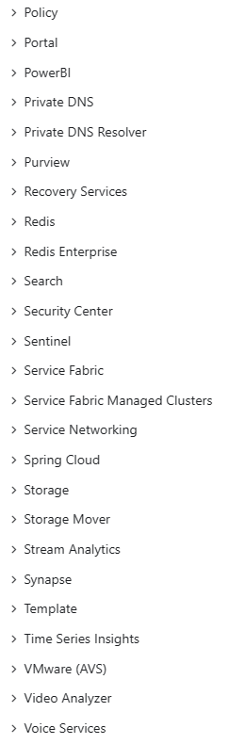
Provider List
https://registry.terraform.io/providers/hashicorp/azurerm/latest/docs
Notes:
Docs overview | hashicorp/azurerm | Terraform | Terraform Registry

Slide 11
First Terraform Project
Notes:
Browse Providers | Terraform Registry

Slide 12
First Configuration
Setup Azure Provider
Create Resource Group
Create Service Plan
Create App Service

Slide 13
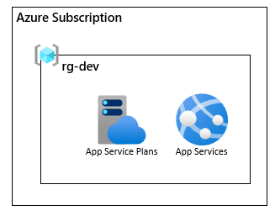
DEMO
Notes:
Folder: Demos/Exemplo01-Basic
Show the .terraform folder (state local)

Slide 14
Basic Commands
Notes:
Basic CLI Features | Terraform | HashiCorp Developer

Slide 15
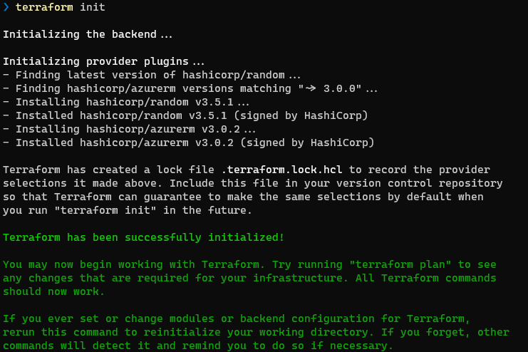
Terraform Commands
Init
Initializes a working directory containing Terraform configuration files. This is the first command that should be run after writing a new Terraform configuration.

Slide 16
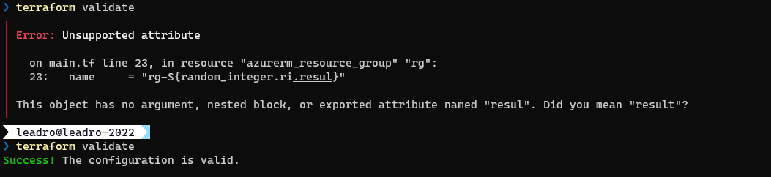
Terraform Commands
Validate
Runs checks that verify whether a configuration is syntactically valid and internally consistent, regardless of any provided variables or existing state. Not accessing any remote services such as remote state, provider APIs, etc.

Slide 17
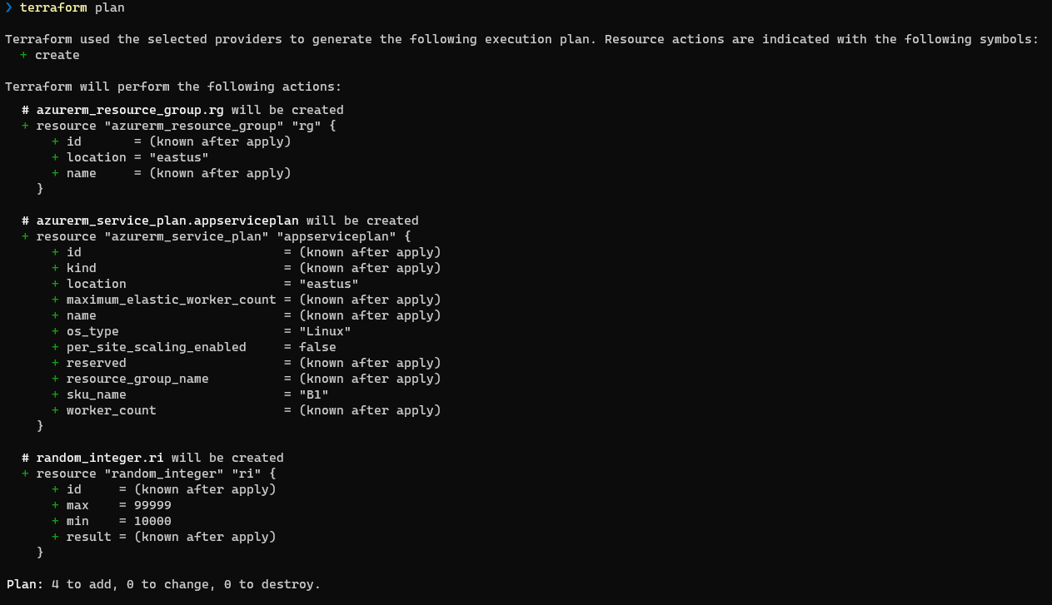
Terraform Commands
Plan
Creates an execution plan, which lets you preview the changes that Terraform plans to make to your infrastructure.
additions indicated by a “+” symbol, and highlighted in green
modifications indicated by a “~” symbol and highlighted in orange
deletions will be indicated by a “– “ symbol and highlighted in red

Slide 18
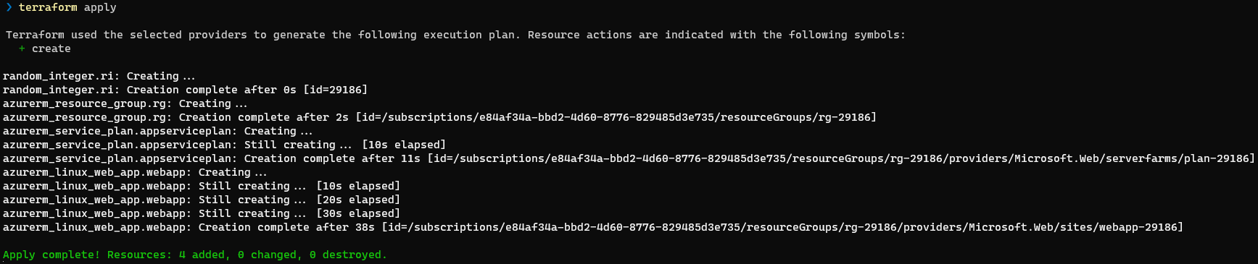
Terraform Commands
Apply
Executes the actions proposed in a Terraform plan.

Slide 19
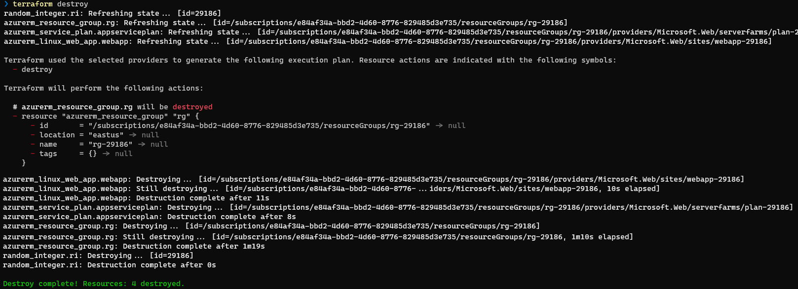
Terraform Commands
Destroy
Convenient way to destroy all remote objects managed by a particular Terraform configuration.

Slide 20
Terraform Workflow
init
validate
plan
apply
destroy
Initializing working directory
Download provider version
Analyzing modules
Backend initialization
Runs checks that verify whether a configuration is syntactically valid and internally consistent
Compares code changes to current state
Creates a list of instruction to migrate the state to the desired changes
Creates a plan file with the list of instruction (no execution)
Actual Infrastructure: Applies the set of instruction created in the plan file
Actual Infrastructure: Remove all configured resources

Slide 21
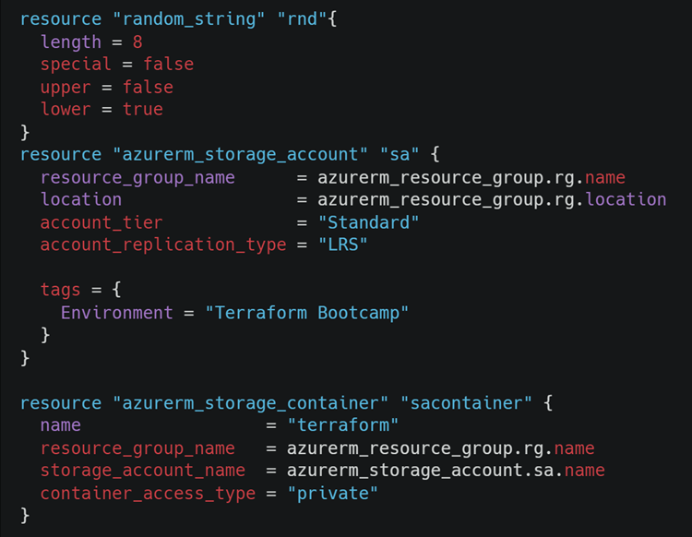
Terraform Dependencies
Terraform can automatically keep track of dependencies
Based on references within resources

Slide 22
Terraform Data Sources & Resources
Data Source
Use information defined outside of Terraform, defined by another separate Terraform configuration, or modified by functions.
Resource
Most important element in the Terraform language.
Each resource block describes one or more infrastructure objects

Slide 23
DEMO
Notes:
Folder: Demos/Exemplo01-Basic
Show the .terraform folder (state local)

Slide 24
Store Terraform state in Azure

Slide 25
Terraform State
Terraform state is used to reconcile deployed resources with Terraform configurations.
State allows Terraform to know what Azure resources to add, update, or delete.
By default, Terraform state is stored locally, which isn't ideal for the following reasons:
Local state doesn't work well in a team or collaborative environment.
Terraform state can include sensitive information.
Storing state locally increases the chance of inadvertent deletion.
Notes:
Store Terraform state in Azure Storage | Microsoft Learn

Slide 26
Terraform State – Storage Account
Use Azure storage to store remote Terraform state.
$RESOURCE_GROUP_NAME=rg-tfstate
$STORAGE_ACCOUNT_NAME=strtfstate
$CONTAINER_NAME=tfstate
# Create resource group
az group create --name $RESOURCE_GROUP_NAME --location eastus
# Create storage account az storage account create --resource-group $RESOURCE_GROUP_NAME --name $STORAGE_ACCOUNT_NAME --sku Standard_LRS --encryption-services blob
# Create blob container az storage container create --name $CONTAINER_NAME --account-name $STORAGE_ACCOUNT_NAME
Notes:
Store Terraform state in Azure Storage | Microsoft Learn

Slide 27
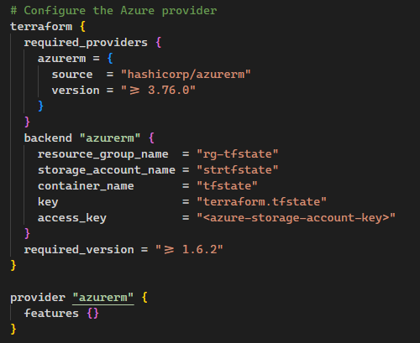
Terraform State – Terraform backend
To configure the backend state, you need the following Azure storage information:
resource_group_name: The name of the Azure Resource Group
storage_account_name: The name of the Azure Storage account.
container_name: The name of the blob container.
key: The name of the state store file to be created.
access_key: The storage access key.
Notes:
Store Terraform state in Azure Storage | Microsoft Learn

Slide 28
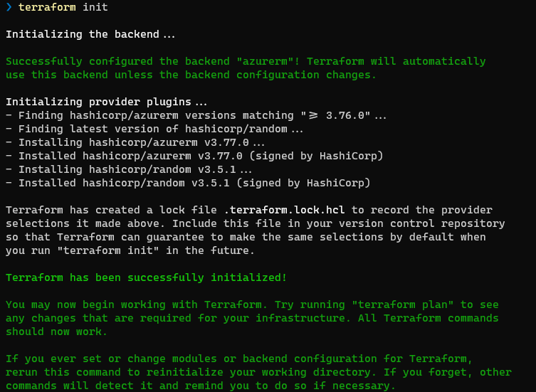
Terraform State – Terraform backend
Notes:
Store Terraform state in Azure Storage | Microsoft Learn

Slide 29
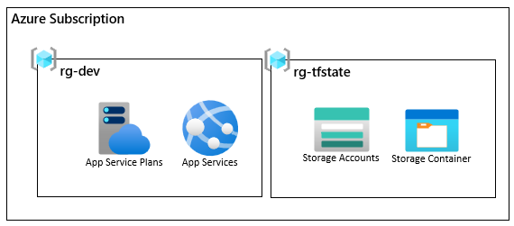
DEMO
Notes:
Folder: Demos/Exemplo02-Backend

Slide 30
Terraform State – Terraform backend
We recommend that you use an environment variable for the access_key value. Using an environment variable prevents the key from being written to disk.
$ACCOUNT_KEY=$(az storage account keys list --resource-group $RESOURCE_GROUP_NAME --account-name $STORAGE_ACCOUNT_NAME --query '[0].value' -o tsv)
export ARM_ACCESS_KEY=$ACCOUNT_KEY
Notes:
Store Terraform state in Azure Storage | Microsoft Learn

Slide 31
DEMO
Notes:
Folder: Demos/Exemplo03-BackendEnvironmentVariable

Slide 32
HCL (HashiCorp Configuration Language)

Slide 33
HCL Language
One language
Cross Platform
Blocks containing key/value pairs
HCL is not JSON
Supports inline comments
“#” – “//” – “/* */”
Case sensitive!

Slide 34
Files
Main
Containing the resource blocks which define the resources to be created in the target cloud platform.
Providers
containing the terraform block, Azure backend definition, provider configurations, and aliases.
Variables
Containing the variable declarations used in the resource blocks.

Slide 35
Files
Outputs
Containing the output that needs to be generated on successful completion of “apply” operation.
*.tfvars
Containing the environment-specific default values of variables.
*.tftest.hcl
Containing the unit test to validate that configuration updates do not introduce breaking changes.

Slide 36
Variables Types
Primitive Type
string
number
bool
Complex
list
map
set
Notes:
Types and Values - Configuration Language | Terraform | HashiCorp Developer

Slide 37
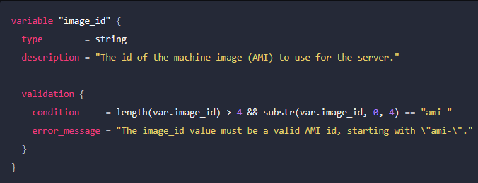
Variables Validation
You can specify custom validation rules for a particular variable by adding a validation block

Slide 38
Operators
Arithmetic Operators
adding (a + b)
subtracting (a – b)
multiplying ( a * b)
dividing (a / b)
remainder (a % b)
Equality Operators
the same type and the same value (a == b)
the opposite (a != b)
Comparison Operators
less (a < b)
less than or equal (a <= b)
greater (a > b)
greater than or equal (a >= b)
Logical Operators
Or (a || b)
And (a && b)
! (!a)
Notes:
Types and Values - Configuration Language | Terraform | HashiCorp Developer

Slide 39
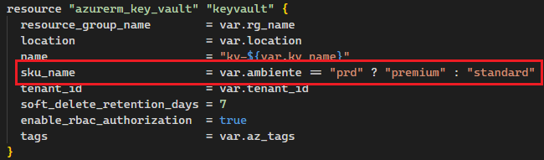
Conditional Expressions
A conditional expression uses the value of a boolean expression to select one of two values.

Slide 40
DEMO
Notes:
Folder: Demos/Exemplo04-Files

